Slide 1
XT-101

Slide 2

K.Srivatsan - vatsank@gmail.com
IT Trainer Since 1991
Conducting CorporateTraining Since 2004
About 60+ Corporate Clients

Slide 3

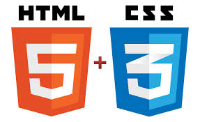
Tim Berners-Lee

Slide 4
Day 1
Introduction to Web Programming
  HTML / CSS/ JS - An introduction
  Programming Tools & debugging
  Introduction to HTML5
  HTML5 - How We Got Here
  Apache Server
  Semantic Tags
  HTML Tables
  Hands on exercises

Slide 5
Introduction to HTML ,CSS, JavaScript
Introduction to Web Programming
  HTML / CSS/ JS
Programming Tools & debugging
  Sublime Editor
Introduction to HTML5
New Features of HTML5
HTML5 Structural Tags
  Laying out a Page with HTML5 Page Structure

Slide 6
World Wide Web
Used for Distributed Document Delivery system
Main presentation language is HTML
Uses a client-server model
Two processes
Client
    Sends requests to the server
    Blocks until reply is received
  Server
    Processes requests from clients
    Never blocks
    Can reply to several clients simultaneously

Slide 7
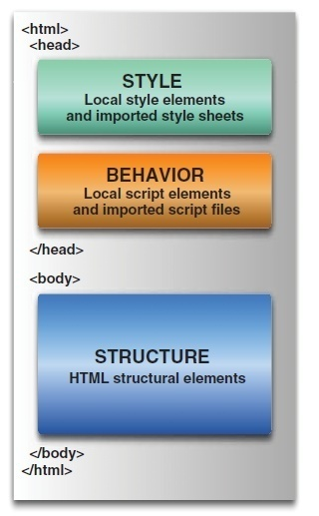
Web page

Slide 8


Slide 9
What is HTML
Hypertext Markup Language.
Based on the Standard Generalized Markup Language (SGML)
Defines a set of common styles for web pages:
  headings, paragraphs, lists, and tables.
  defines character styles such as boldface
These styles are indicated inside HTML documents using tags.
  <h1>Hello World</h1>
HTML element encompasses opening tag, closing tag, content

Slide 10
Evolution of HTML
Tim Berners-Lee made major contribution in Creating HTML in 1989
He Founded the W3C , refined and updated HTML with HTML4 in 1997.,
Growing need for richer Web content
  audio, video and interactivity ,Plug-in applications such as Flash
Web Hypertext Application Technology Working Group (WHATWG) in 2004,
  Created with the involvement of Apple, the Mozilla Foundation and Opera
In 2006 WHATWG developed the new standard named HTML5
  released in 2008, web browsers have increasingly incorporated the new standard

Slide 11
Web Browser
A software application for retrieving, presenting, and traversing information resources on the World Wide Web.
An information resource is identified by a Uniform Resource Identifier (URI) and may be a web page, image, video, or other piece of content.
They are primarily intended to access the World Wide Web, they can also be used to access information provided by Web servers in private networks or files in file systems.

Slide 12
Why Web Browser
Released by Tim Berners-Lee in in March, 1991.
  “Well, I found it frustrating that in those days, there was different information on different computers, but you had to log on to different computers to get at it.
  Also, sometimes you had to learn a different program on each computer.”
      Tim Berners-Lee.

Slide 13
Popular Broswers
Desktop :
  Chrome, FireFox, Safari , IE, Opera etc
  Usage : {Chrome, FireFox, Safari } = 71%
Mobile and Tablet :
  Android Browser, iPhone, Opera Mini, Opera-Mobile,
  Nokia S40/S60, Chrome, Firefox etc
  Usage :{Android Browser, iPhone, Chrome} = 54 %

Slide 14
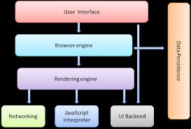
Browser Structure

Slide 15
Browser Structure
User interface:
  The address bar, back/forward button, bookmarking menu, etc.
Browser engine:
  marshals actions between the UI and the rendering engine.
Rendering Engine :
  responsible for displaying requested content.
  parses HTML and CSS,
  Displays the parsed content on the screen.
Networking:
  Uses HTTP requests, can be different implementations for different platform

Slide 16
Browser Structure
UI backend:
  used for drawing basic widgets like combo boxes and windows.
  This backend exposes a generic interface that is not platform specific.
  Underneath it uses operating system user interface methods.
JavaScript interpreter.
  Used to parse and execute JavaScript code.
Data storage.
  Persistence layer.
  Need to save data locally, such as cookies.
  localStorage, IndexedDB, WebSQL and FileSystem.

Slide 17

Rendering Engine
By default display only HTML, XML and image.
Beyond above things, we need extension/Add-on/Plug-ins
Also called as Layout Engine
Rendering Engine
  Chrome and Opera : Blink
  Chrome (iPhone) & Safari : WebKit
  Firefox : Gecko
  IE : Trident

Slide 18
What is HTML5?
Latest standard for HTML.
Designed to replace both HTML 4, XHTML, HTML DOM Level 2.
Designed to deliver rich content without the need for additional plugins.
Animation to graphics, music to movies, and can also be used to build complicated web applications.
Cross-platform.
It is designed to work with PC, or a Tablet, a Smartphone, or a Smart TV.

Slide 19
The Latest Specification
New Mark Up + JavaScript API = HTML5
HTML 5 specification is now feature complete, meaning nothing more will be added to it,
Browser vendors now have a stable target to write for.
  May take some more time until all major browsers will support all recommended HTML 5 features.
To test the many features supported by a Browsers
  http://html5test.com/

Slide 20
Page Simplification
HTML5 has made some simplifications to the page:
The new doctype is simply: <!DOCTYPE HTML>.
  The doctype is specified to ensure that browsers render the page in standards mode; the statement is case-insensitive.
The character set is simply declared with: <meta charset="UTF-8">.
  This tells the browser to use the UTF-8 character encoding, ensuring that the browser won't display characters as gibberish.
The type attribute is no longer required on <style> and <script> tags.
  The default types are CSS and ECMAScript, respectively.

Slide 21
Browser Support for HTML5
The major browsers support and add the new HTML5 elements and APIs,
Chrome (25) , Firefox(20) Internet Explorer (9),
Safari (5.1) , Opera (12.0)
Designed, as much as possible, to be backward compatible with existing web browsers.
Can detect support for individual HTML5 features using a few lines of JavaScript.

Slide 22
Advantages of HTML 5
Easy to integrate multimedia and graphical content without using flash and third party plugins.
Semantic HTML tags Instead of “div” tags
Use of fancier forms with native validation.
Different type of text inputs and search
Instead of cookies usage of Local Storage.
Geo-location APIs make location directly available.
Worker Threads
Offline Storage and Query

Slide 23
HTML became XHTML
HTML was originally a SGML application
  Tags described the syntax
  A DTD could check the syntax
  Informal mapping from syntax to rendering
Multiple incompatible versions arose
  Tag abuse was rampant in the ’net
  They were a plague unto the users

Slide 24
XHTML Basics
Very few real changes from HTML
But more strict
All tags are in lowercase
All tags must be closed
  Empty tags
  Paired tags
3 Parts to an XHTML or HTML document
  DOCTYPE
    What DTD are you using
  Head
    Meta information
    Only <title> is required
  Body
    Text to render

Slide 25
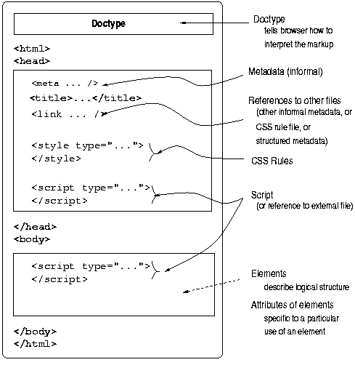
XHTML Document Structure

Slide 26
What is a Tag
Tags are ;
surrounded with angle brackets like this
    <B> or <I>.
Most tags come in pairs
    exceptions: <P>, <br>, <li> tags …
The first tag turns the action on, and the second turns it off.
The second tag(off switch) starts with a forward slash.
    For example ,<B> text </B>
can be embedded
    <HEAD><TITLE> Your text </HEAD></TITLE> it won't work.
    The correct order is <HEAD><TITLE> Your text </TITLE></HEAD>
not case sensitive
Many tags have attributes.
    For example, <P ALIGN=CENTER> centers the paragraph following it.

Slide 27
Structuring HTML
HTML defines three tags that are used to describe the page's overall structure and provide some simple header information.
  <html>
  <head>
  <body>
These tags don't affect what the page looks like when it's displayed; they're only there to help tools that interpret or filter HTML files.
In the strict HTML definition, these tags are optional.

Slide 28
Creating a HTML Document
  Use an text editor to write the document.
  Save the file as filename.html
  Open any browser Off-Line
  Click on File, Open File and select the filename.html document that you just created.
  Your HTML page should now appear just like any other Web page in Netscape.

Slide 29
Sublime Editor
Sublime Text 3 is one of the fastest code editors
Has a community and plugin ecosystem
Download the installer
    http://www.sublimetext.com/3
  Many aspects of Sublime Text can be extended or customized.
Looks for resources inside the packages folder.
package
  a folder that contains resources that belong together
  Ctrl+ e for Completions

Slide 30
Package Locations
There are three locations for storing packages for different purposes.
Packages with the .sublime-package extension
Installed Packages
Application/Packages
Can be installed in two main ways:
  by copying Sublime Text resources to a folder under Packages, or
  by copying a .sublime-package file to Installed Packages.

Slide 31
Basic HTML
  <!DOCTYPE html>
  <html>
  <head>
  <meta charset="UTF-8">
  <title>First Example</title>
  </head>
  <body>
  <header>
  <h1> HTML 5 and CSS 3</h1>
  <h2> HTML 5 Examples</h2>
  <h4> Chapter - 1</h4>
  </header>
  </body>
  </html>

Slide 32
The <html> Tag
The html element represents the root of an HTML document.
It indicates that the content of this file is in the HTML language.
All the text and HTML elements in web page should be placed within the beginning and ending HTML tags
It is a better practice to specify a lang attribute on this element
  Aids speech synthesis tools to determine what pronunciations to use,
  Translation tools to determine what rules to use
<html lang="en">

Slide 33
HTML Global Attributes
Global attributes may be specified on all HTML elements
Class
  Specifies one or more classnames for an element (refers to a class in a style sheet)
Id
  Specifies a unique id for an element
Style
  Specifies an inline CSS style for an element
Accesskey
  specifies a shortcut key to activate/focus an element
Tabindex
  Specifies the tabbing order of an element
Title
  Specifies extra information about an element

Slide 34
Html Global Attributes
Hidden
  Is a Boolean attribute indicates that the element is not yet, or is no longer, relevant.
  This attribute must not be used to hide content that could legitimately be shown.
Contenteditable
  indicating if the element should be editable by the user.
  True which indicates that the element must be editable;
  false, which indicates that the element must not be editable.

Slide 35
Html Global Attributes
data-*
  custom data attributes,
  Proprietary information to be exchanged between the HTML and its DOM
dir
  indicating the directionality of the element's text.
  ltr, which means left to right and is to be used for languages that are written from the left to the right (like English);
  rtl, which means right to left and is to be used for languages that are written from the right to the left (like Arabic);
  auto, which let the user agent decides.

Slide 36
Html Global Attributes
Spellcheck
  The spellcheck attribute specifies whether the element is to have its spelling and grammar checked or not.
  Text values in input elements (not password)
  Text in <textarea> elements
  Text in editable elements

Slide 37
Head - Tag
<HEAD>...</HEAD>
  contains information about the document
  specifies that the lines within the opening and closing tag are the prologue to the rest of the file.
  It contains most notably, the page title.
<TITLE>...</TITLE>--
  <title> tags are placed within the page header
  Each HTML page needs a title to indicate what the page describes.
  It appears in the title bar of the browser when viewed
  The title is stored in your browser's favorites (or bookmarks),
  May also be used by search engines while indexing pages.
.

Slide 38
<link>
TO link document to other resources.
The destination of the link(s) is given by the href attribute
The types of link indicated (the relationships) are given by the value of the rel attribute
The possible supported tokens are icon, stylesheet.
  Should only include the tokens from this list that the user agent implements the processing model for.

Slide 39
<link>
  <html>
  <head>
  <base href="images/">
  </head>
  <body>
  <div id="imgTab">
  <img name="pict" src="pastries.jpg" alt="pastries" onmouseover="document.pict.src='Image2.jpg'" onmouseout="document.pict.src='pastries.jpg'">
  </div>
  </body>
  </html>

Slide 40
Meta Data
Metadata within an HTML document:- information about data.
<meta name="description" content="A general guide on the use of meta tags in html pages">
No effect on search engine rank
  But appear in search results.
  People can read description on a search results page before clicking on link
  A good meta description will not improve but ranking, it will increase click-through rates to your website from search pages.
_x000b_

Slide 41
Meta-Tags
<head>
<meta charset="UTF-8">
<meta name="description" content=“Training Materials">
<meta name="keywords" content="HTML,CSS,XML,JavaScript">
<meta name="author" content=“Ramesh">
</head>
https://html.spec.whatwg.org/multipage/semantics.html#the-meta-element

Slide 42
Character Set
character encoding
  Tells how to interpret raw zeroes and ones into real characters.
  It usually does this by pairing numbers with characters.
  ASCII, 8-bit encodings, and Unicode-based encodings.
ASCII
  is a 7-bit encoding based on the English alphabet.
8-bit
  extensions to ASCII that add useful, non-standard characters like é and æ.
Unicode-based
  implement the Unicode standard and include UTF-8, UTF-16 and UTF-32/UCS-4.
  They go beyond 8-bits and support almost every language in the world.

Slide 43
Character Set
The ASCII Character Set
  ASCII uses the values from 0 to 31 (and 127) for control characters.
  ASCII uses the values from 32 to 126 for letters, digits, and symbols.
  ASCII does not use the values from 128 to 255.
The ISO-8859-1 Character Set
  8859-1 is identical to ASCII for the values from 0 to 127.
  8859-1 does not use the values from 128 to 159.
  8859-1 is identical to UTF-8 for the values from 160 to 255.

Slide 44
Character Set
The UTF-8 Character Set
  UTF-8 is identical to ASCII for the values from 0 to 127.
  UTF-8 does not use the values from 128 to 159.
  UTF-8 is identical to both ANSI and 8859-1 for the values from 160 to 255.
  UTF-8 continues from the value 256 with more than 10 000 different characters.

Slide 45
Deprecated Tags in HTML5
<acronym> : Defines an acronym
<applet> : Defines an applet
<center> : Defines centered text
<font> : Defines text font, size, and color
<frame> : Defines a frame
<frameset> :Defines a set of frames

Slide 46
Body Tag
Defines the main content of the HTML document or the section of the HTML document that will be directly visible on web page.
This tag is also commonly referred to as the <body> element.
<body></body>
  <body>
    <h1>Heading</h1>
    <p>This is the content.</p>
  </body>

Slide 47
Headings
Headings are used to add titles to sections of a page
. HTML defines six levels of headings.
  <h1>Installing Your Safety Lock</h1>
The numbers indicate heading levels (H1 through H6).
They're displayed in larger or bolder text, are centered or underlined, or are capitalized so that they stand out from regular text.

Slide 48
Headings
  <HTML>
  <HEAD>
  <TITLE>Document Headings</TITLE>
  </HEAD>
  <BODY>
  Samples of the six heading types:
  <H1>Level-1 (H1)</H1>
  <H2 >Level-2 (H2)</H2>
  <H3><U>Level-3 (H3)</U></H3>
  <H4 >Level-4 (H4)</H4>
  <H5>Level-5 (H5)</H5>
  <H6>Level-6 (H6)</H6>
  </BODY>
  </HTML>

Slide 49
Paragraphs
<p> tag was used to indicate the end of a paragraph and not the beginning.
Multiple <P>'s do not create blank lines
Use <BR> for blank line
Fully-specified text uses <P> and </P> ,but </P> is optional

Slide 50
Preformatted Text
Text in an HTML file is formatted based on the HTML tags used to mark up that text.
The preformatted text tag <pre>
This tag retains any white space that you put into text surrounded by the <pre> and </pre> tags is retained in the final output.
The spacing in the text in the HTML source is preserved when it's displayed on the page.
Used to align text by padding it with spaces, used in simple tables.

Slide 51
<PRE> Preformatted Text
  <PRE>
  if (a < b) {
  a++;
  b = c * d;
  }
  else {
  a--;
  b = (b-1)/2;
  }
  </PRE>

Slide 52
List Tags- Unordered List
List tags begin and end the entire list.
This will create a list with bullets next to the list items.
The is <ul> ... </ul>.
To set off each item in list, the <li> tag, followed by text, then close each list item with the </li> tag.
<ul type=“disc”>
<li>I am item one</li>
<li>I am item two</li>
</ul>
The type attribute to specify the type of bullets to be used in the list.
  disc, circle, square

Slide 53
List Tags- Ordered List
Ordered List
Created using <ol></ol>,
<ol>
<li>Item 1</li>
<li>Item 2</li>
<li>Item 3</li>
</ol>
Ordered List can also be specified with type , to use uppercase Roman numerals,
<ol type="I">
<li>Roman I</li>
<li>Roman II</li>
</ol>
“1” , “A”,”a”,”I” are the possible value for the type

Slide 54
Comments
Comments in HTML pages to describe the page itself or to provide some kind of indication of the status of the page.
Text in comments is ignored when the HTML file is parsed;
Comments don't ever show up on screen
  <!-- This is a comment -->

Slide 55
Creating Links
<a href="http://www.someplace.com">Display Text</a>
“a” stands for anchor, and the href="" is asking for a location to link to. The </a> is the closing tag.
The text between the tags is what will show up on your Web page as a link.
"local url".
  Any file for which the to create a local url link , the file should be in the same directory as the page you are editing.
  <a href="linking.htm">Linking to Other Pages</a>

Slide 56
Horizontal Rules & Line Break
The <hr> tag, which has no closing tag in HTML and no text associated with it, creates a horizontal line on the page.
Rule lines are used to visually separate sections of a web pagejust before headings,
  To separate body text from a list of items.
Line Break
The <br> tag breaks a line of text at the point where it appears.
When a web browser encounters a <br> tag, it restarts the text after the tag at the left margin

Slide 57
Physical Character Style
    <H1>Physical Character Styles</H1>
    <B>Bold</B><BR>
    <I>Italic</I><BR>
    <U>Underlined</U><BR>
    Subscripts: f<SUB>0</SUB> + f<SUB>1</SUB><BR>
    Superscripts: x<SUP>2</SUP> + y<SUP>2</SUP><BR>
    <SMALL>Smaller</SMALL><BR>
    <BIG>Bigger</BIG><BR>
    <STRIKE>Strike Through</STRIKE><BR>

Slide 58
Image
SRC is required
WIDTH, HEIGHT may be in units of pixels or percentage of page or frame
  WIDTH="357"
  HEIGHT="50%"
Images scale to fit the space allowed
Align=position
  Left : Image on left edge; text flows to right of image
  Right : Image on right edge; text flows to left
  Top : Image is left; words align with top of image
  Bottom : Image is left; words align with bottom of image
  Middle : Words align with middle of image

Slide 59
Inline Images in HTML: The <img> Tag
Inline images are placed in HTML documents using the <img> tag.
Adding Alternative Text to Images
When client cannot present then there is graceful degradation
  Providing an alternative version or making the user aware of shortcomings of a product as a safety measure to ensure that the product is usable
<img src="myimage.gif" alt=“picture of a cat" />

Slide 60
Images and Links
Image can serve as a link
Add an <img> tag inside a link tag (<a>), that image serves as a link itself:
<a href="index.html"><img src="uparrow.gif" alt="Up" /></a>
Both an image and text in the link tag, they become links to the same page:
<a href="index.html">
  <img src="uparrow.gif" alt="Up" />Up to Index</a>

Slide 61
<A> Anchors (HyperLinks)
Link to an absolute URL:
  If you get spam, contact
  <A HREF="htttp:www.microsoft.com“>Microsoft </A> to report the problem.
Link to a relative URL:
  See these <A HREF="#references"> references </A>
  concerning our fine products.
Link to a section within a URL:
  Amazon provided a <A HREF="www.amazon.com/#reference">
  reference for our company. </A>

Slide 62
Naming a Section
You can link to another part of the same web page by adding an id attribute to almost any HTML tag, and then link to it by adding a pound sign (#) at the beginning of where the destination url goes
Clicking on the link will take you to the HTML element with that id.
<p id="part16">
Part 16
HTML Made Easy
</p>
<a href=“#part16”>software Required</a>

Slide 63
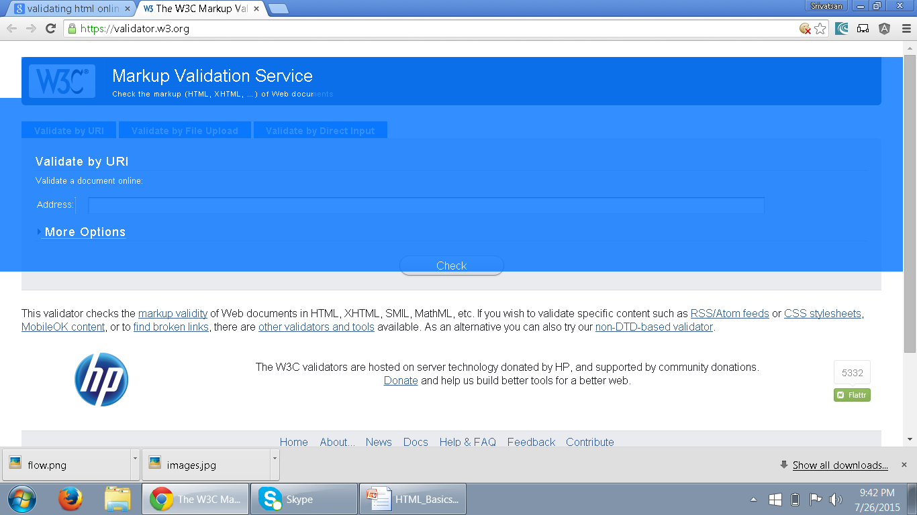
Validating HTML
The validator service checks the markup validity of Web documents in HTML, XHTML, SMIL, MathML, etc
https://validator.w3.org/
.

Slide 64
Cascading StyleSheets (CSS)
The main aim of HTML was to create content for a web page.
HTML tags when used for formatting the web pages, made websites cumbersome and expensive.
Hence, CSS was created by World Wide Web Consortium (W3C) in order to separate out formatting from content creation.
Cascading StyleSheets were introduced from HTML 4.0 where all formatting tags were moved to a separate external .css file.

Slide 65
CSS Usage
Specify point size and font of text;
Set margins within a web page;
Create a distinctive style for individual web pages or sets of web pages;
Format style to one element of a web page or to a numerous pages;
Control color of different elements of a web page;

Slide 66
Style Rule
A Style Rule is composed of two parts: a selector and a declaration.
TH {color: red;}.
The Selector indicates the element to which the rule is applied.
The Declaration determines the property values of a selector.
Selector
Declaration

Slide 67
Style Rule
The Property specifies a characteristic, such as color, font-family, position, and is followed by a colon (:).
The Value expresses specification of a property, such as red for color, arial for font family, 12 pt for font-size, and is followed by a semicolon (;).
        P {color: red;}
Value
Property

Slide 68
Using External Style Sheet
Style Rules can be expressed in an external Style Sheet - a text document that doesn’t contain any HTML code. There is no <STYLE> element in an external style sheet.
External Style Sheet has a .css extension.
h1, h2, h3
{
font-family: verdana, arial, 'sans serif';
color: #9933FF;
text-align: center;
}

Slide 69
Using the <STYLE> Element
The <STYLE> element is always positioned in the <HEAD> section of the document.
The <STYLE> element always contains <TYPE> attribute. The value “text/css” defines the style language as Cascading Style Sheets.
  <Head>
  <Style type=“text/css”>
  P {
  color:blue;
  font-size: 24pt;
  }
  </Style>
  </Head>

Slide 70
Cascading StyleSheets (CSS)
  Extenal StyleSheet
    can be applied to any number of pages in the website
    will not contain HTML tags
    <link> tag is used to link the Web page to an external style sheet.
    Href URL Specifies the location of the linked document
    Rel Specifies the relationship between the current document and the linked document
      Can be Author,bookmark,Icon,external, Help,search,sidebar,stylesheet,tag

Slide 71
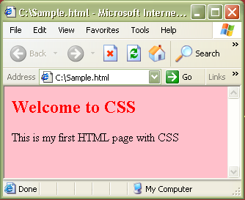
CSS – External StyleSheet Example
<html>
<link rel="stylesheet" type="text/css" href=“my_style.css" />
<h2> Welcome to CSS </h2>
<body> This is my first HTML page with CSS </body>
</html>
Sample.html
Path to the .css file
h2 {color:red}
body {background-color:pink}
my_style.css
Output:

Slide 72
CSS – Internal StyleSheet
  Internal StyleSheet
    can be applied to a particular page that needs a unique format.
    should be included in the head section of HTML page
    <style> tag is used to hold the values for formatting

Slide 73
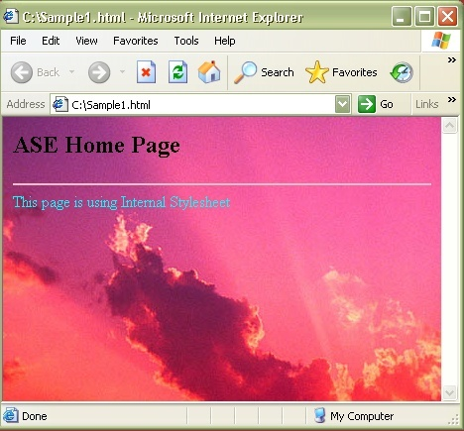
CSS – Internal StyleSheet Example
<html>
<head>
<style type="text/css">
hr{color:pink}
font {color:cyan}
body {background- image:url('c:\Sunset.jpg')}
</style>
<h2> ASE Home Page</h2>
</head>
<hr>
<body>
<font>
This page is using Internal Stylesheet
</font>
</body>
</html>
Output :

Slide 74
CSS – Inline StyleSheet
  Inline StyleSheet
    style attribute is used in the relevant tag.
    style attribute can contain any CSS property.
    For example:
    <html>
    <p style="color:blue">This is a example of inline stylesheet</p>
    </html>

Slide 75
Working with Tables

Slide 76
<table> - Element
  To tabulate data in columns and rows.
  Used for displaying tabular data.
  As data displayed in a spreadsheet
  Its inappropriate use for tables just for layout.
  <table>
  <tr>
  <th>Name</th>
  <th>ID</th>
  </tr>
  <tr>
  <td>Ramesh</td>
  <td>10000</td>
  </tr>
  </table>

Slide 77
Table
Two Elements are used to create data within each row
<th>...</th>
  elements are used for heading cells.
  Browsers center the contents
  text is rendered in the boldface.
<td>...</td>
  Used to render table data.

Slide 78
Basic Styling
Padding :
  Defines the amount of space between the edges of the cells and the content inside a cell.
Width :
  Can be applied to individual cells <th> or <td>
  width attribute in cells can be pixel or a percentage
  Useful when multiple columns of identical widths, regardless of their contents

Slide 79
Basic Styling
  table{
  border: 2px solid blue;
  border-collapse:collapse;
  }
  th,tr,td{
  border: 2px solid blue;
  }
  td{
  padding:0px 10px 0px 10px;
  width: 30px;
  }

Slide 80
Head and Body
<thead>
  Can semantically indicate that the first row was the header of the table.
  must appear after any <caption> element
  Must appear before any <tbody>, <tfoot> and <tr> element
<tfoot>
  defines a set of rows summarizing the columns of the table.
  Can be used as a child of a <table> element, after any <caption>, and <thead>
  Can be used before any <tbody> and <tr> elements.
.

Slide 81
ColSpan
To create a cell that spans multiple rows or columns
Can be added to the <th> or <td> elements,
The data within that cell then fills the entire width or length of the combined cells
  <body>
  <table>
  <tr> <th colspan="2">Gender</th> </tr>
  <tr> <th>Male</th> <th>Female</th> </tr>
  <tr>
  <td>15</td>
  <td>23</td>
  </tr>
  </table>
  </body>

Slide 82
Table Example
  <table>
  <caption>Conference Schedule</caption>
  <thead>
  <tr>
    <th>Item Number</th>
    <th>Item Name</th>
    <th>Quantity</th>
    <th>Rate</th>
    <th>Amount</th>
  </tr>
  </thead>

Slide 83
Table Example
  <tbody>
  <tr>
    <td>101</td>
    <td>Cake</td>
    <td>1</td>
    <td>200</td>
    <td>200</td>
  </tr>
  </tbody>
  <tfoot>
        <tr>
        <td colspan="4">Total</td>
        <td>200</td>
        </tr>
  </tfoot>
  </table>

Slide 84
Basic Styling
  table{
  border: 2px solid blue;
  border-collapse: collapse;
  margin: auto;
  }
  thead {
  background-color: grey;
  }
  tfoot {
  background-color: lightgray;
  }
  caption{
  font-style: 'Arial';
  }
  tr,td {
  border: 2px solid blue;
  text-align: center;
  }

Slide 85
Semantic markup
HTML is oriented towards design
  element in it should have well-structured content.
Semantic markup :
  self-describing and uses the correct HTML elements for the correct job.
<div id="heading" style="font-size:300%; padding: 10px;">
My heading
</div>
Its not heading in terms of meaning or purpose.

Slide 86
Advantage of Semantic Markup
Search engine optimization
  keywords in headings have more weight,
Accessibility
  screen readers use heading elements as navigational signposts
Development
  it is a lot trickier to target elements with styles and scripts when you don't use proper semantic elements
Lightweight
  removing all those nested <divs> and other spaghetti code.
This makes file sizes smaller and coding easier.

Slide 87
Structural Elements
Elements that are replacements for the common ad hoc semantics applied using class and id attributes
Header
  Header content for a page or a section of page
Footer
  footer content for a page or a section of the page
Section
  A section in a web page
Article
  Independent article content
Aside
  Related content or pull quotes
nav
  Navigational aids

Slide 88
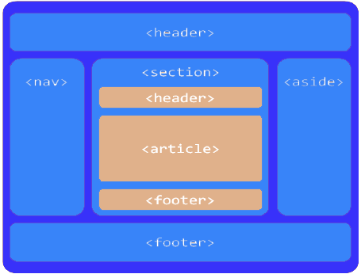
Page Layout

Slide 89
  a group of introductory or navigational aids.
  contains the section’s heading (an h1–h6 element or an hgroup element),
  but can also contain other content, such as a table of contents, a search form, or any relevant logos
Generally placed at the beginning of page.
Can be multiple headers, each of which will then become the for that section of the document
<header>
<h1>The most important heading on this page</h1>
<p>With some supplementary information</p>
</header>.

Slide 90
represents a footer for its nearest ancestor sectioning content or sectioning root element.
contains information about its section such as who wrote it, links to related documents, copyright data
  Can use multiple footers, each of which will then become footer for that section of the document
  <footer>
  <ul>
  <li>copyright</li>
  <li>sitemap</li>
  <li>contact</li>
  <li>to top</li>
  </ul>
  </footer>

Slide 91
Section
Used for sectioning, more or less like a <div> element.
  “The <section> element represents a generic section of a document or application.
  “When an element is needed only for styling purposes or as a convenience for scripting, authors are encouraged to use the div element instead
  A general rule is that the section element is appropriate only if the element’s contents would be listed explicitly
First, the section element is technically style-able, but it is suggested to instead use<div> when we are more likely to apply heavy styles or script to the element.
Secondly, similar to <li> element, the general idea of section element is to list content.

Slide 92
Section Element
the section element’s content should be “thematic,”
Some examples of acceptable uses for section elements include:
individual sections of a tabbed interface
segments of an “About” page; for example,
  a company’s “About” page might include sections on the company’s history, its mission statement, and its team
various sections of an online news site;
  articles could be grouped into sections covering sports, world affairs, and economic news

Slide 93
Example
  <footer>
  <section id="authors">
  <section id="copyright">copy Right 2014-2015</section>
  </section>
  </footer>
  </div>
  </body>

Slide 94
<article> Element
“A self-contained composition in a document, page, application, or site and that is, in principle, independently distributable or reusable,
Used exclusively for structuring article, common usage of article
  forum posts
  magazine or newspaper articles
  blog entries
  user-submitted comments
article elements can be nested inside other article elements.
You can also nest a section inside an article, and vice versa.

Slide 95
<aside> Element
Defines content which is stand alone from the page content
Used to define the text surrounded by its familiar content.
Used for creating some index related to the topic.
Can be used in sidebar of a page, whenever user clicks on the index, it redirects the user on the related content.
Can be used to represent some block quote content in an article

Slide 96
Example
  <div id="main">
  <div id="primary">
  <article>
  </article>
  </div>
  <div id="content">
  <article>
  <aside></aside>
  </article>
  </div>
  </div>

Slide 97
<nav> Element
The nav element stands for Navigation.
  “A section of a page that links to other pages or to parts within the page: a section with navigation links.”
Usage is not limited to only the primary navigation, typically at the top of the web page.
Can also be used on any part of the page that also acts as a navigator,

Slide 98
Example
  <body>
  <div id="wrapper">
  <header>
  <h1>HTML5 Document Structure Example</h1>
  <nav id="navigation">
  <ul id="nav-list">
  </ul>
  </nav>
  </header>

Slide 99
figure

Slide 100
figureCaption

Slide 101
Progress
To view the completion progress of a task.
Displayed as a progress bar.
Javascript can be used to manipulate the value of progress bar.
Max
  describes how much work the task indicated by the progress element requires.
  a valid floating point number greater than Zero
Value
  specifies how much of the task that has been completed.
  It must be a valid floating point number between 0 and max, or between 0 and 1 if max is omitted.
  If there is no value attribute, the progress bar is indeterminate; this indicates that an activity is ongoing with no indication of how long it is expected to take.
<progress value="70" max="100">70 %</progress>

Slide 102
Progress
  function show() {
  var pbar = document.getElementById('prgrs');
  pbar.value=pbar.value+10;
  }
  <progress id='prgrs' value="20" max="100">
  <span>0</span>% </progress>
  <button onclick="show()">Begin</button>

Slide 103
Details and Summary
Used as a disclosure widget from which the user can retrieve additional information.
Open :
  Boolean attribute indicates whether the details will be shown to the user on page load.
  Default is false and so details will be hidden.
Used as a summary, caption, or legend for the content of details
  The default style is display:list-item

Slide 104
Meter
Represents either a scalar value within a known range or a fractional value.
Value
  The current numeric value.
  This must be between the minimum and maximum values
  Default value is 0.
It will be equal to nearest End
  If not value will be within the range of min and max attribute

Slide 105
Meter
Min
  The lower numeric bound of the measured range.
  Must be less than max attribute
Max
  The upper numeric bound of the measured range.
  Must be greater than min attribute

Slide 106
Meter
Low
  The upper numeric bound of the low end of the measured range.
  Must be greater than the min and less than high and max
  If unspecified, or if less than the minimum value, the low value is equal to the minimum value.
High
  The lower numeric bound of the high end of the measured range.
  Must be less than max and must be greater than low and min
  If unspecified, or if greater than the maximum value, the high value is equal to the maximum value.

Slide 107
Meter
The current value of the meter element is by default green when the value attribute falls inside the low-high range.
<meter min="0" low="40" high="90" max="100“ value="84">A</meter>
Gives a yellow color to the meter element when the value attribute falls outside the low-high range.
  <meter min="0" low="40" high="90" max="100“ value="94">B</meter>
Gives a red color to the meter element when the value and the optimum attributes fall outside the low-high range but in opposite zones.
  <meter min="40" low="60" high="90" max="100“ value="95" optimum="30">C</meter>

Slide 108
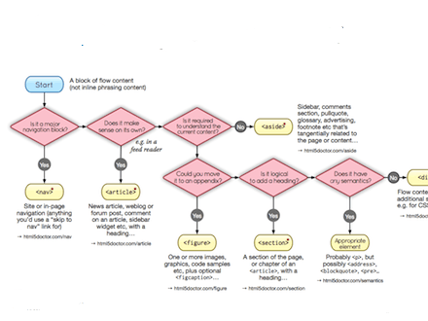
HTML5 Elements

